Slide 1

2021 2-2 Computer Systems
Project #2
Team 8
18102088
20102117
20102125
Lee Jaeyu
Lee Jeonghyeon
Pi Yujin
Notes:
Our 8th group is Lee Jae-yu, Lee Jung-hyun, and Pi Yu-jin. I'll begin a presentation from now on.

Slide 2
Contents
01
Memory
Hierarchy
02
Data
03
Scenario
Notes:
I will briefly explain the memory hierarchy and the data used, and show you an example of outputting results according to the scenario.

Slide 3


00
Intro
Java
IntelliJ IDEA
Notes:
The programming language we used during this project is Javai, and we used IntelliJ.

Slide 4
01
Memory Hierarchy
Notes:
The first is the memory hierarchy.

Slide 5
01
Memory
Hierarchy
Memory Hierarchy
Based on caching work
Slower storage is cheaper than faster storage
Programs tend to exhibit locality
Locality
temporal locality The same data objects are likely to be reused multiple times. Since the cache is faster than the storage at the next lower level
spatial locality Blocks usually contain multiple data objects. Expect that the cost of copying a block after a miss will be amortized by subsequent references to other objects within that block.
Notes:
Locality has temporal and spatial locality.

Slide 6
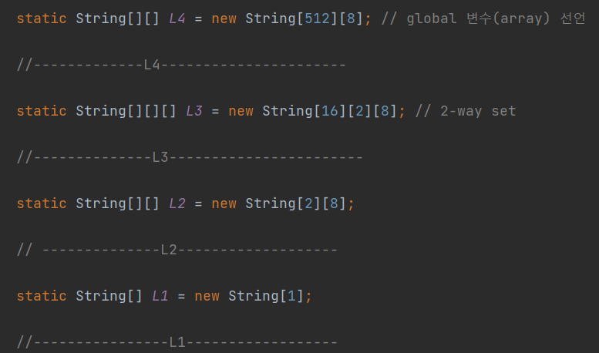
01
Memory
Hierarchy
Memory Hierarchy
L1(1)
L1 = 1 element
L2 = 16 elements
L3 = 256 elements
L4 = 4096 elements
L2(16)
L3(256)
L4(4096)
E-way Set Associative Cache (E=2)
String[][][] L3 = new String[16][2][8];
Notes:
We implemented L1 to L4 in the project.
In order to implement E-way Set Association Cache, we have used array as follows.

Slide 7
02
Data

Slide 8
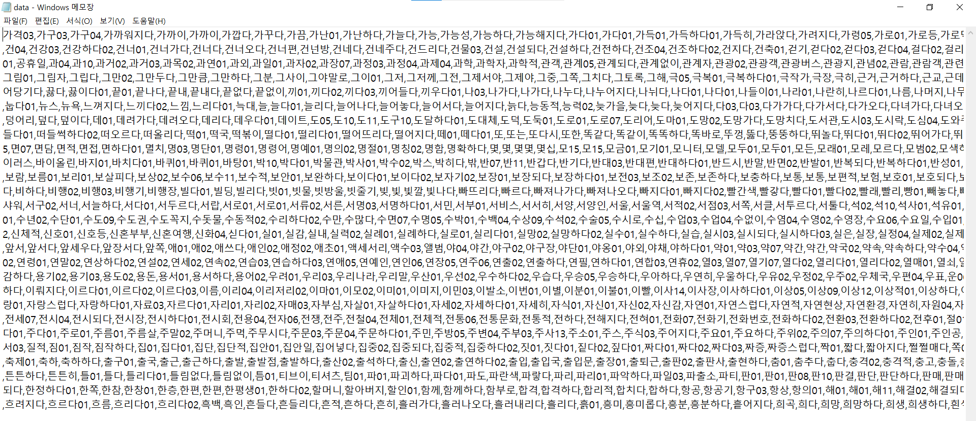
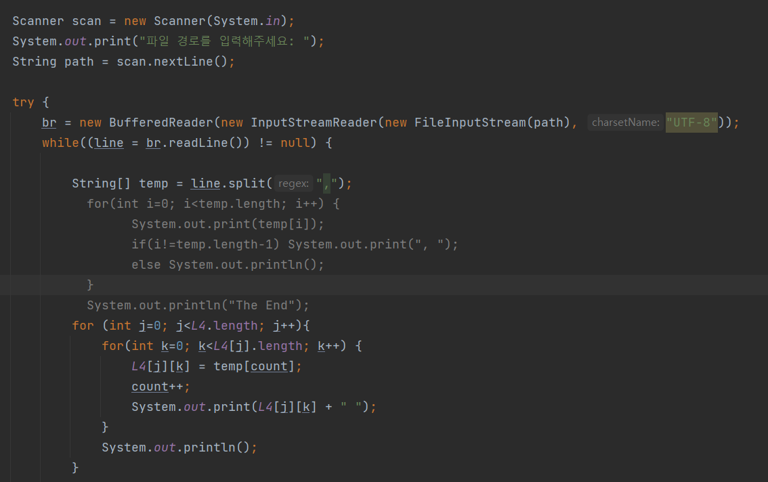
02
Data
Data
국립국어원 – 한국어 학습용 데이터
Size
5965 elements
L4 = 4096 elements < 5965 elements
Notes:
The actual data we actually used is Korean language learning data provided by the National Institute of Korean Language.

Slide 9
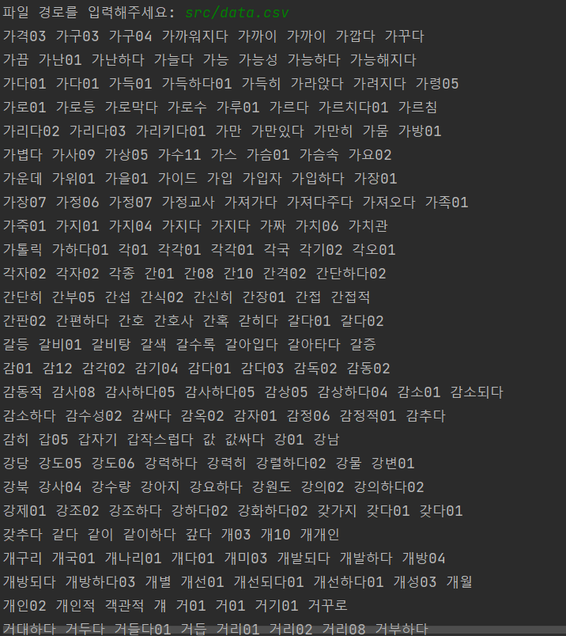
02
Data
Data
국립국어원 – 한국어 학습용 데이터
Size
5965 elements
L4 = 4096 elements < 5965 elements
Notes:
It consists of a total of 5,965 words, and this size is larger than L4, so not all data can be stored in L4.

Slide 10
03
Scenario
Notes:
Now, I will show scenarios with our real-data. We set 4 scenarios that we can show functions of memory hierarchy.

Slide 11
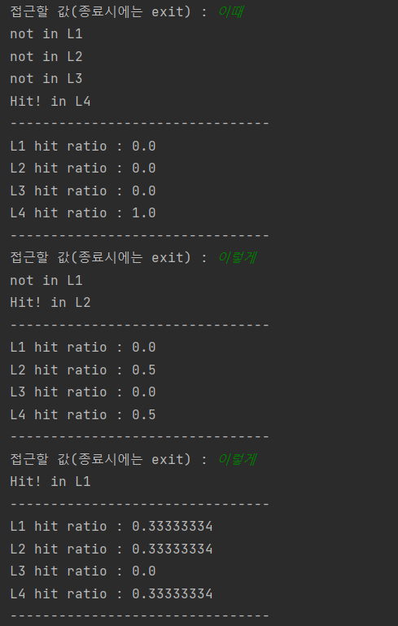
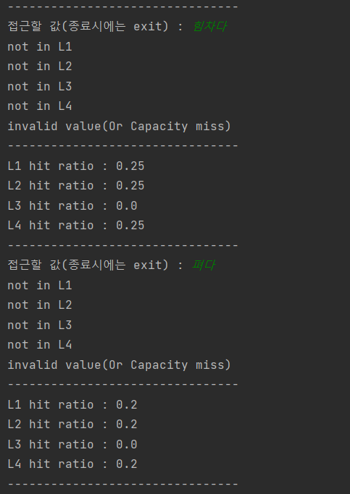
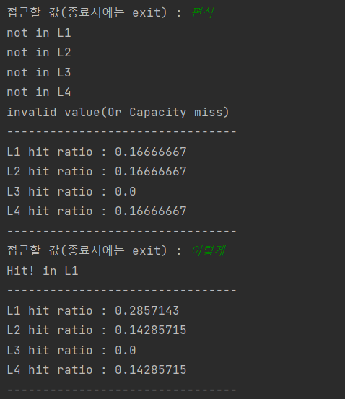
03
Scenario
Capacity miss(invalid value)
이때
이렇게
이렇게
힘차다 (invalid value)
펴다 (invalid value)
편식 (invalid value)
이렇게
Notes:
First of all, we choose some invalid value. Like this result, when we enter the invalid value then it has capacity miss.
At first, if you enter an existing value and then enter a non-existent value, you can see the capacity miss. After that, if you enter the previously entered value again such as ‘이렇게’, it will not change and will be a hit in L1.

Slide 12
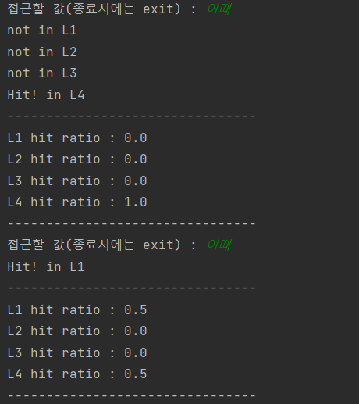
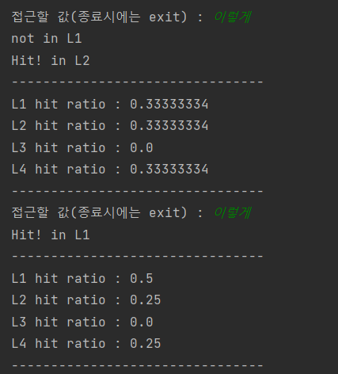
03
Scenario
Hit in L1 and L2
이때 (Hit in L4)
이때 (Hit in L1)
이렇게 (Hit in L2)
이렇게 (Hit in L1)
Notes:
When the word ‘이때’ is the first entered, it is hit in L4, and when it is re-entered, it could be seen that it is stored in L1.
Later, when enter the word ‘이렇게’ which is in the same block offset then they give some message “Hit in L2”. If you enter this word ‘이렇게’ right away, this time L1 will be a hit.
Because L1 has only one element, when a word in the same block offset is entered, it becomes a hit in L2. Only for the word entered just before hit in L1.

Slide 13
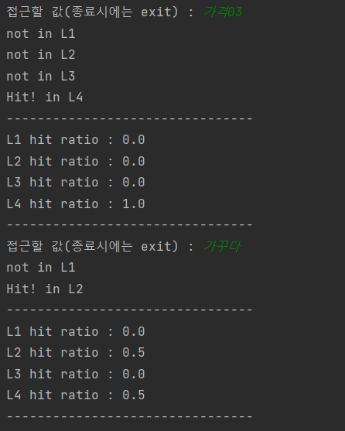
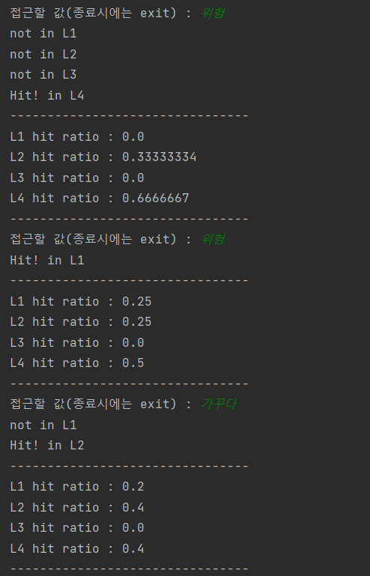
03
Scenario
Cache Locality
가격03 (Hit in L4)
가꾸다 (Hit in L2)
위험 (Hit in L4)
위험 (Hit in L1)
가꾸다 (Hit in L2)
움직이다 (Hit in L4)
운전하다 (Hit in L4)
가격03 (Hit in L3)
Notes:
This is the result of entering words in the order of the above list.
When the first word is entered, L4 becomes a hit because 4096 words are stored only in L4.
Because it has spatial locality, if it is in the same block offset as the previously entered word, it will be a hit in L2.

Slide 14
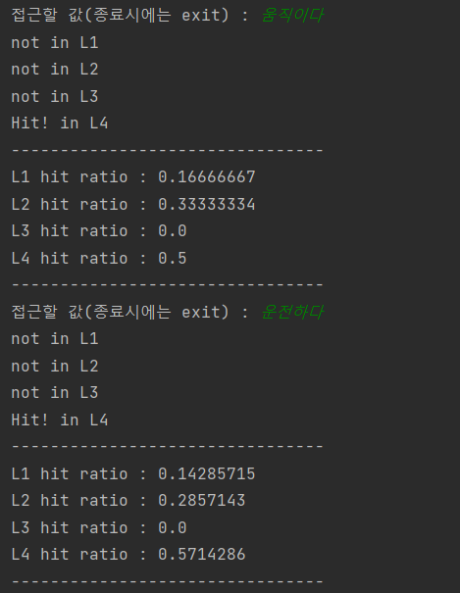
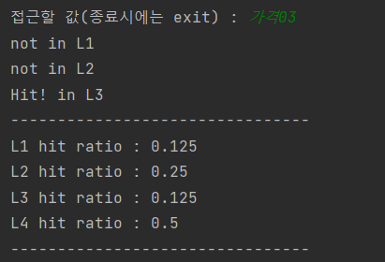
03
Scenario
Cache Locality
가격03 (Hit in L4)
가꾸다 (Hit in L2)
위험 (Hit in L4)
위험 (Hit in L1)
가꾸다 (Hit in L2)
움직이다 (Hit in L4)
운전하다 (Hit in L4)
가격03 (Hit in L3)
Notes:
In addition, if two or more blocks that can be stored in L2 are input, the previously input block disappears and becomes a hit in L3 like the example of ‘가격03’.
And also, we add the code of hit ratio. It was designed to show the percentage of hits by dividing each memory.
When input is performed, the total number increases, and when hits are made in each layer, each variable is added one by one, and variable of the hits in each layer are divided by the total number to calculate the hit ratio.

Slide 15
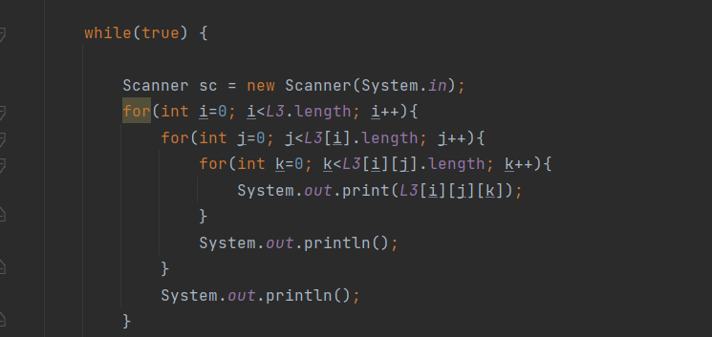
03
Scenario
How to save it in L3
가격03 (Hit in L4)
감소하다 (Hit in L4)
검정색 (Hit in L4)
검은색 (Hit in L2)
감소하다 (Hit in L3)
검정색 (Hit in L3)
Notes:
The output code was temporarily added to confirm the structure stored in L3. We make 2-way set in L3.

Slide 16
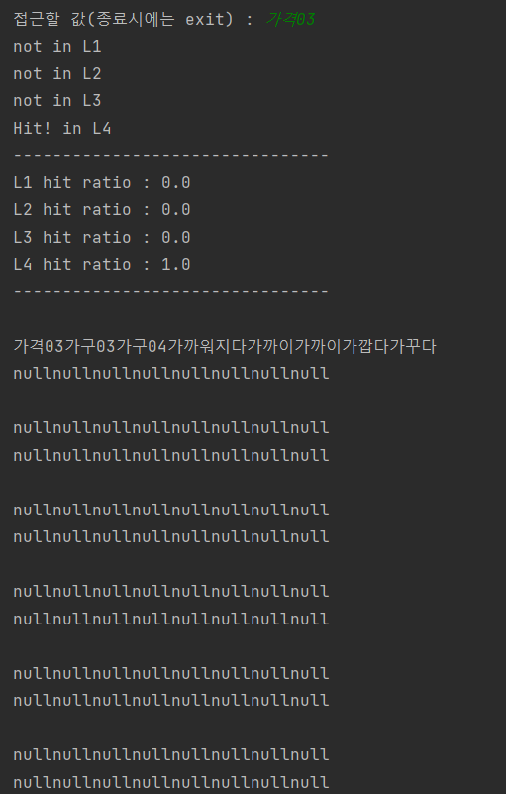
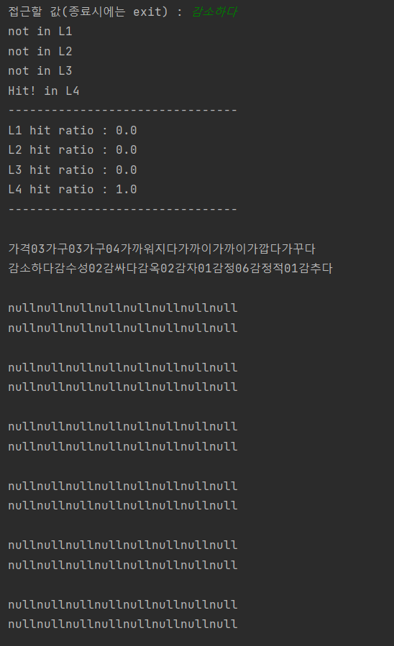
03
Scenario
How to save it in L3
가격03 (Hit in L4)
감소하다 (Hit in L4)
검정색 (Hit in L4)
검은색 (Hit in L2)
감소하다 (Hit in L3)
검정색 (Hit in L3)
Notes:
Each is in a different block offset, but it is entered as blocks stored in the same set such as ‘가격03’, ‘감소하다’, and ‘검정색‘.
We can see the L3 structure and what is stored in it.

Slide 17
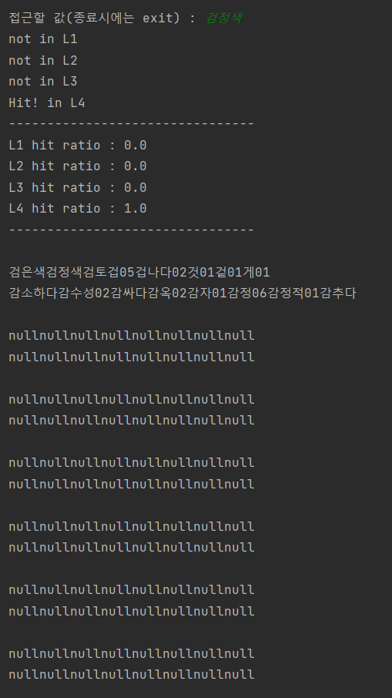
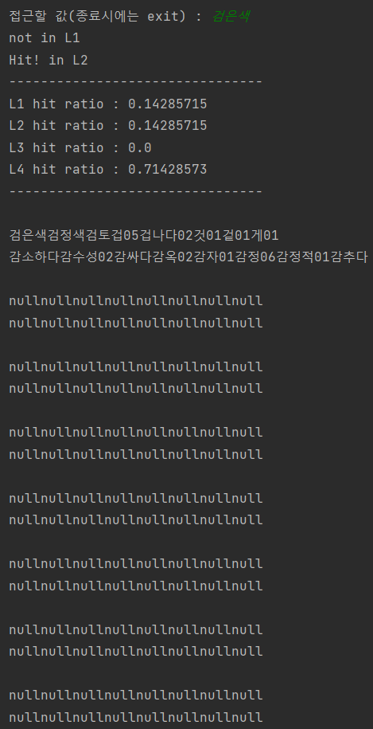
03
Scenario
How to save it in L3
가격03 (Hit in L4)
감소하다 (Hit in L4)
검정색 (Hit in L4)
검은색 (Hit in L2)
감소하다 (Hit in L3)
검정색 (Hit in L3)
Notes:
When we enter the word ‘검정색’, we can see the change of L3 storage. In the first line, it shows that ‘가격03’ block is changed to ‘검정색’ block.

Slide 18
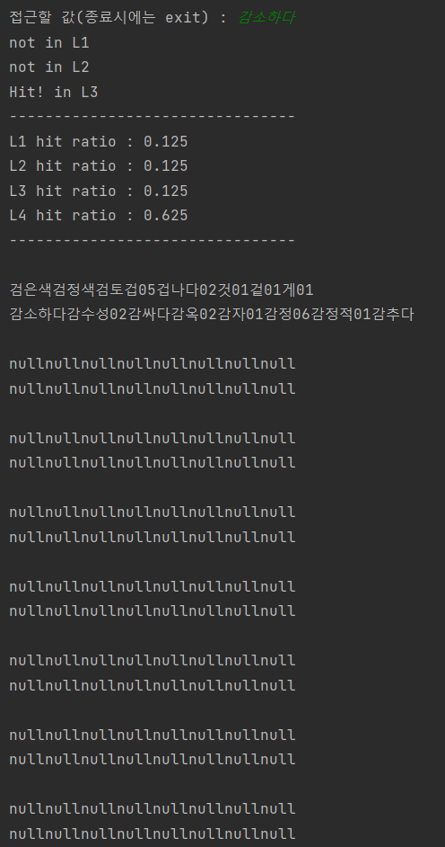
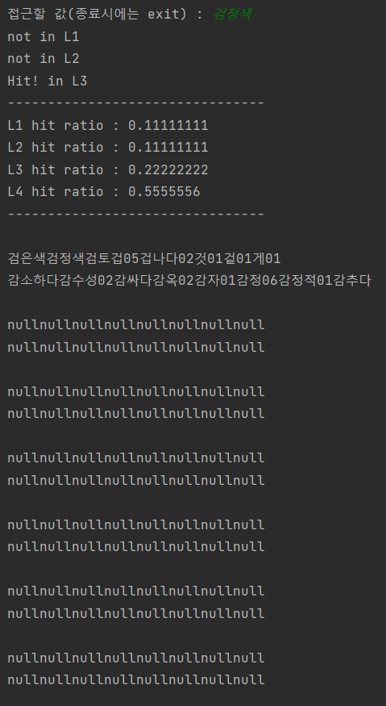
03
Scenario
How to save it in L3
가격03 (Hit in L4)
감소하다 (Hit in L4)
검정색 (Hit in L4)
검은색 (Hit in L2)
감소하다 (Hit in L3)
검정색 (Hit in L3)
Notes:
If we enter a block that goes into the same set like this, we can see that L2 continues to change right off and hit L3 because we set the index for each position so that it can enter a specific position. In this part, it can be seen that these words are designated as the same index of L3 and L2.

Slide 19
Thank you
Notes:
Thank you for listening our presentation.

